Slide 1

Spatial plan for crime prevention in Tartu suburbs
Planning Project
Rachid Berghout

Slide 2







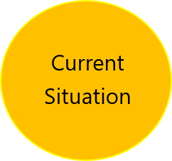
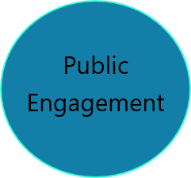
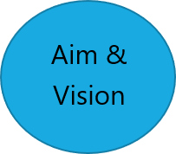
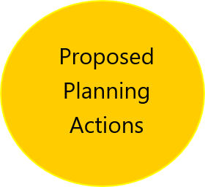
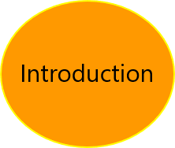
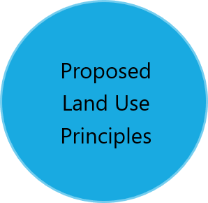

Slide 3
Introduction
Crime
Crime rates and feeling of safety have a significant impact on people's quality of life and lifestyle, their comfort and travel choices.
CPTED
The appropriate architectural design can lead to the construction of an environment that will play a primary role in reducing crime and its frequency, and ultimately improve the quality of life.
Notes:
Community crime prevention measures or strategies should target changes in community infrastructure, culture, or the physical environment in order to reduce crime.

Slide 4
Our Aim
To preserve current safe environment and increase the feeling of safety in Vahi, Kõrveküla and Tila villages by introducing crime mitigation measures.

Slide 5
AUDREY FARREL -
LEARN FROM THE PAST
LIVE IN THE PRESENT
PLAN FOR THE FUTURE
Our Vision

Slide 6
Current Situation
Vahi, Kõrveküla and Tila villages

Slide 7
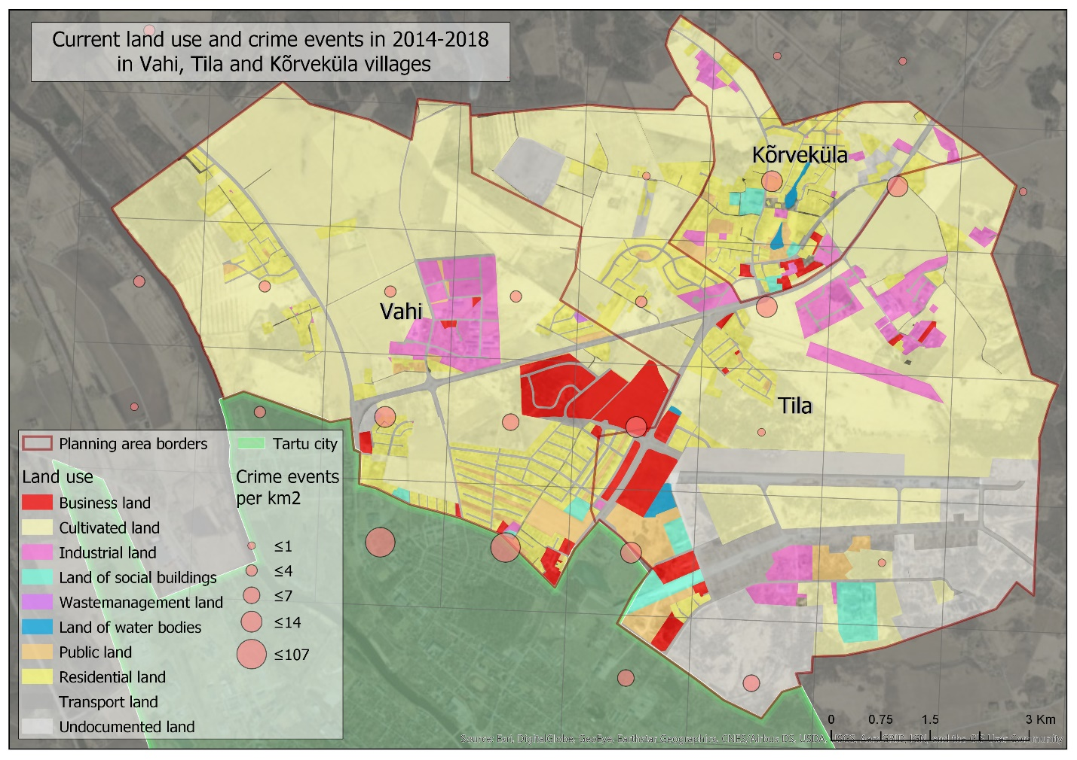
Place your screenshot here

Slide 8
Temporal patterns of crime

Slide 9
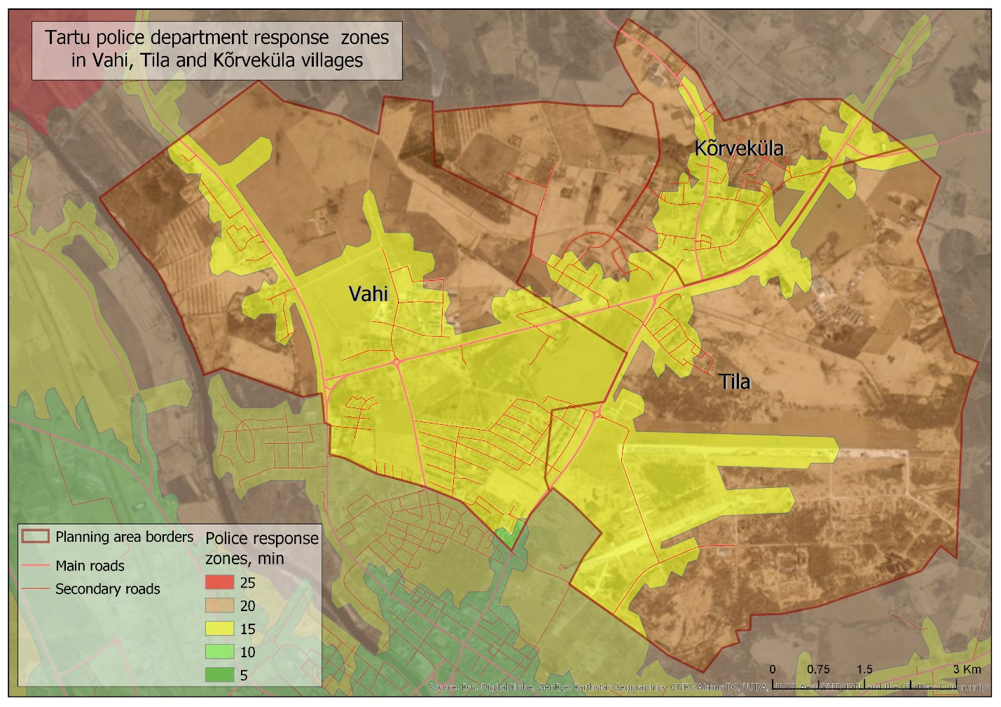
Place your screenshot here

Slide 10
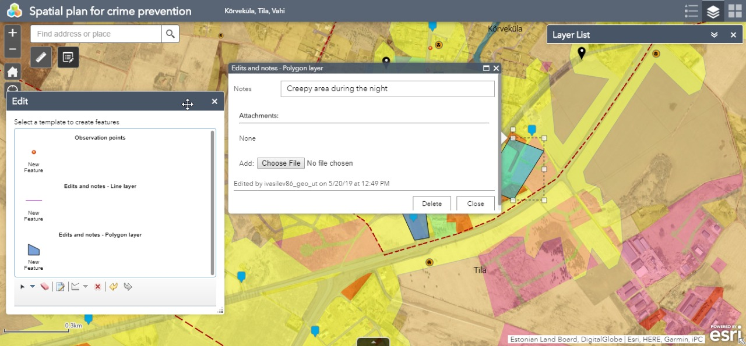
Public Engagement
This gives local people a voice and an opportunity to influence our considerations before decisions are made or priorities are set, and in return, it allows us to access new information, ideas and suggestions, and measure residents’ satisfaction with the current situation.
Notes:
Engaging the residents in this work and in such projects at large is a key factor in the development of the field of planning, and this engagement is critical to the acceptance of the future-planned measures to mitigate crime in the targeted villages

Slide 11
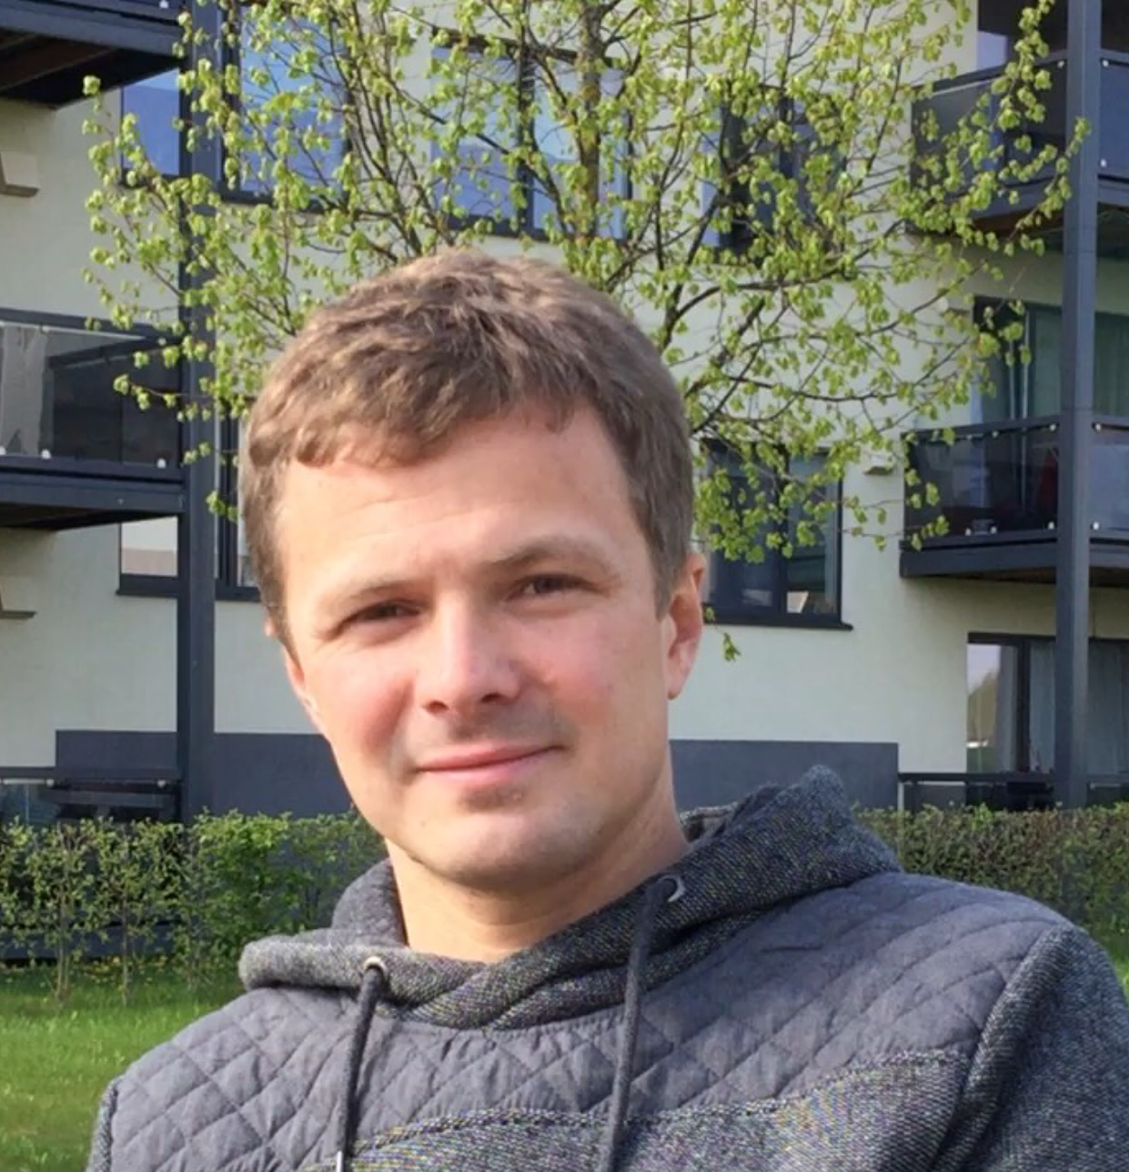
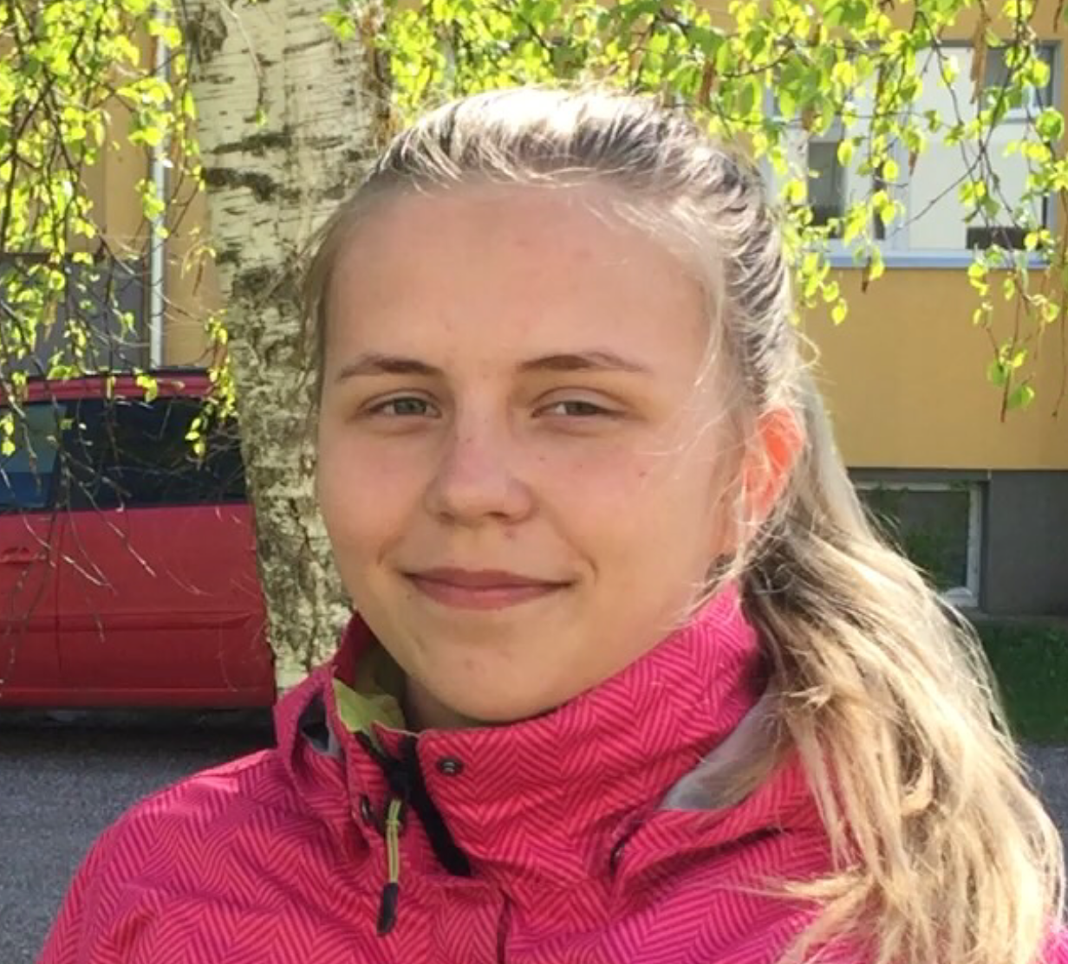
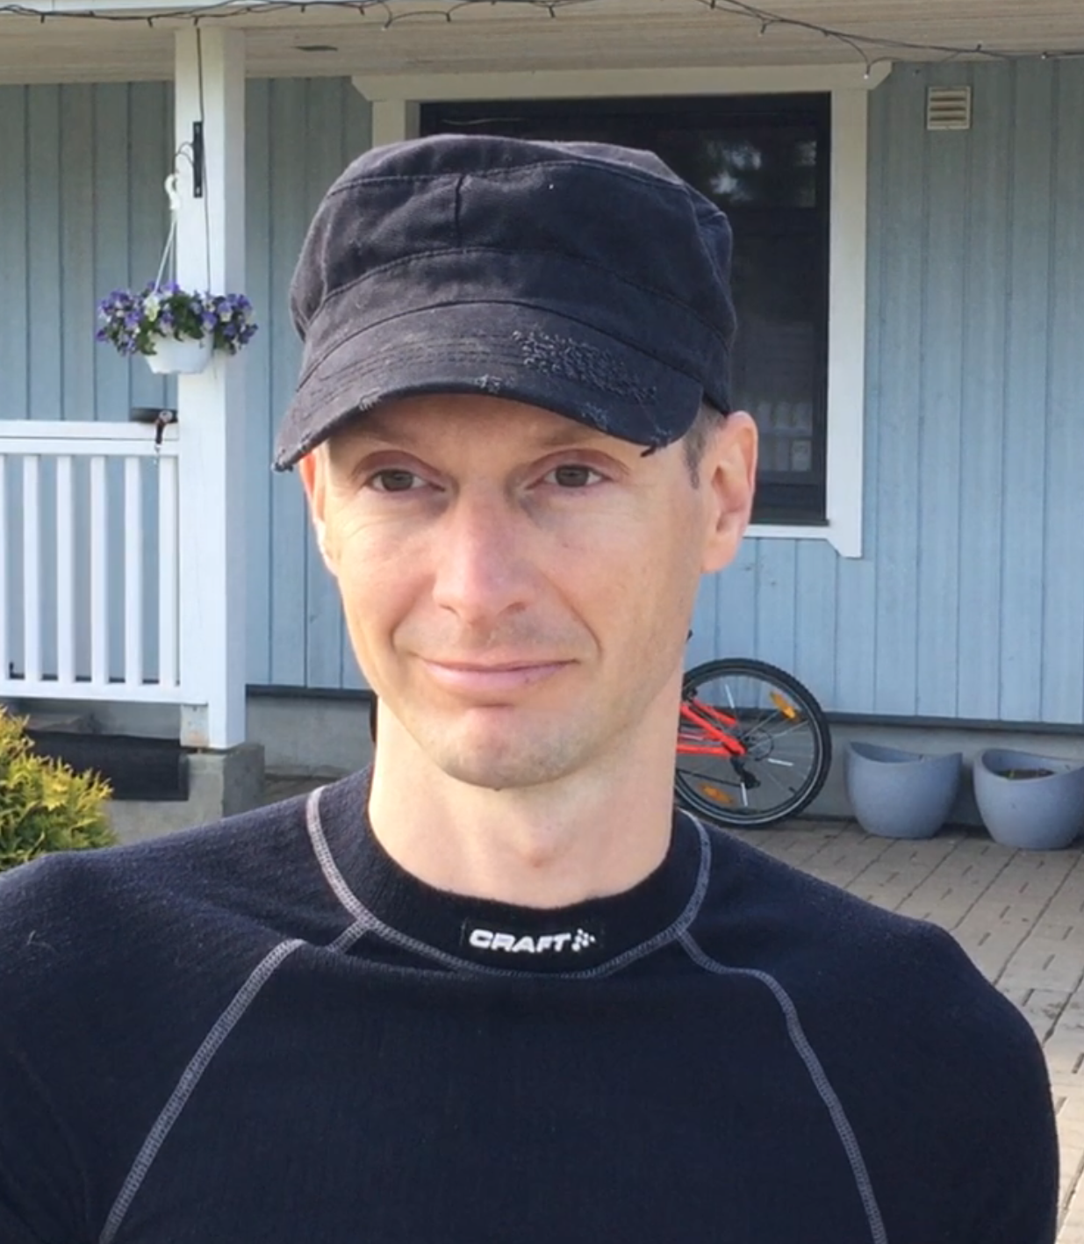
Public Engagement
This gives local people a voice and an opportunity to influence our considerations before decisions are made or priorities are set, and in return, it allows us to access new information, ideas and suggestions, and measure residents’ satisfaction with the current situation.
Erki
Agerine
Harles
Kõrveküla
Vahi
Tila
Notes:
There is a need to know more detail about how the residents see crime issues in their neighbourhoods, and how it affects them. This gives local people a voice and an opportunity to influence our considerations before decisions are made or priorities are set, and in return, it allows us to:
• To access new information, ideas and suggestions.
• To improve planning, outlined measures and decision making.
• To measure residents’ satisfaction with the current situation.

Slide 12
Proposed Land use Principles

Slide 13
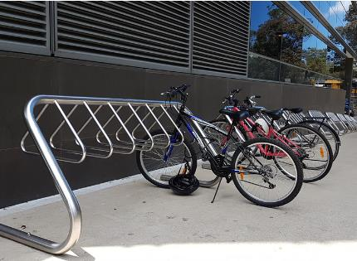
Bike racks
Planning bike racks is important.
Not only does it improve the appearance of the area, it ensures that poles and benches intended for pedestrians are not cluttered by bikes that do not have a designated parking space.
Such case is encountered in Kõrveküla village

Slide 14
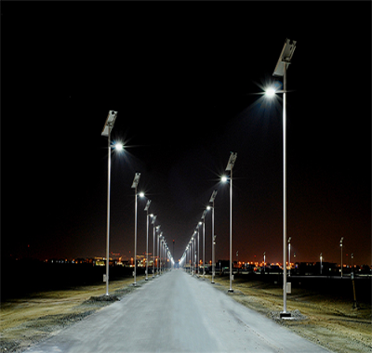
Street lighting
Street lighting is much needed in several areas in the visited villages to deter the perpetration of criminal acts.
Improved street lighting can be an effective means of reducing crimes such as burglary and theft.
There is a widely held belief that the improvement of street lighting and visibility will increase the feeling of safety.

Slide 15

Signage
Street signs are important instrument in crime prevention and improvement of safety feeling.
Signs help to inform potential criminals about consequences and prevent an attempt of crime. Signs also could be used to raise an awareness among neighborhood dwellers.

Slide 16
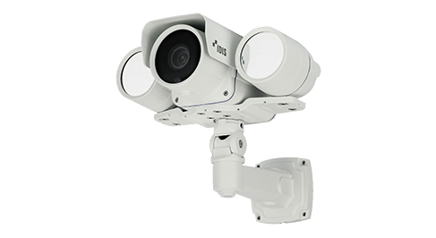
Surveillance cameras
A residential security system is becoming more and more important to prevent crime and theft around.
Putting surveillance cameras in commercial areas and hotspots will help in the incarceration of criminals.

Slide 17
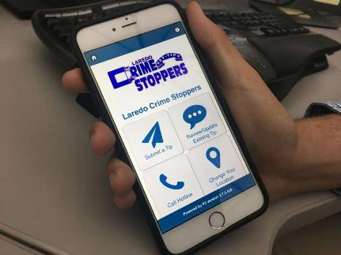
Raising awareness
Awareness is required before applying any safety or crime mitigation measures.
Building relations between the police, safety structures and community members should be a priority.

Slide 18
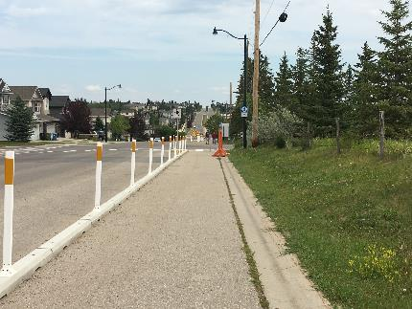
Pedestrian paths
Along the length of the roads, pedestrian paths are nonexistent or beat into the grass. For pedestrians, it is not comfortable and it is not safe.
Sidewalks are needed to tackle the risks of road crime and pedestrian accidents.

Slide 19
Proposed Planning Actions

Slide 20
The content of the proposals
Spatial context
Plan
Proposals
Examples

Slide 21
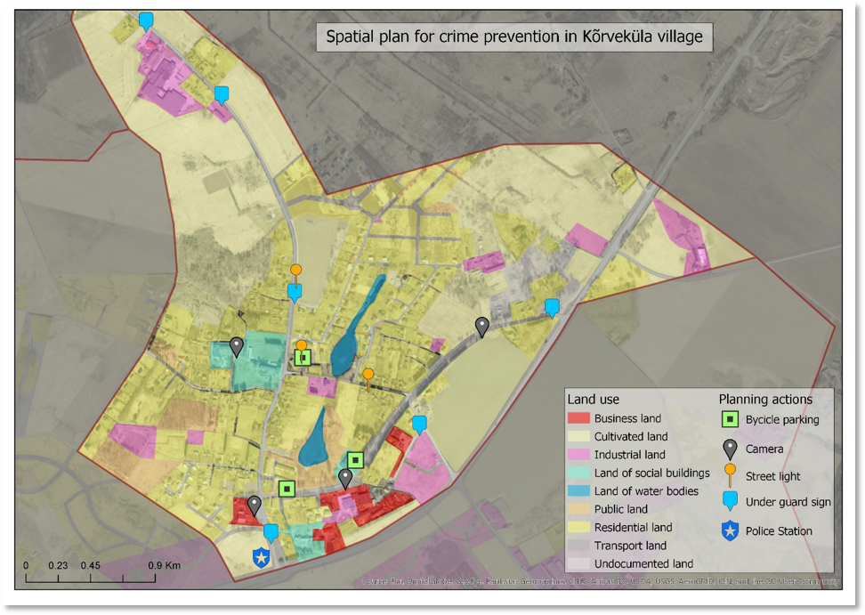

Slide 22
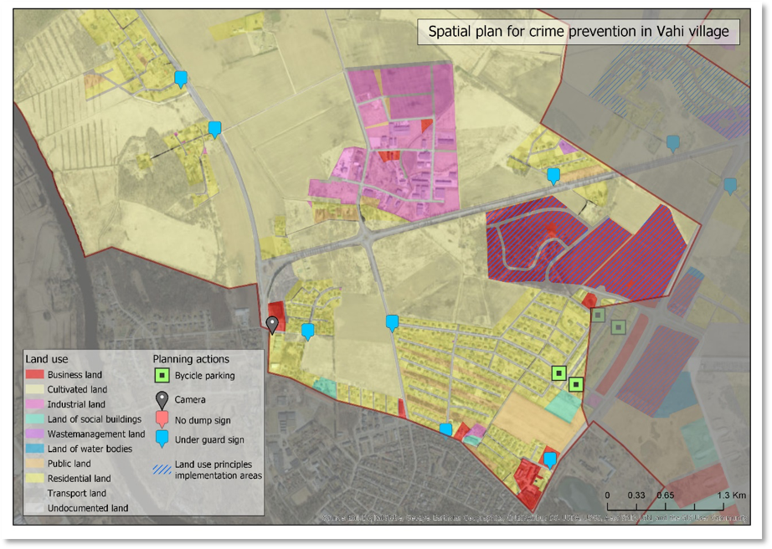

Slide 23
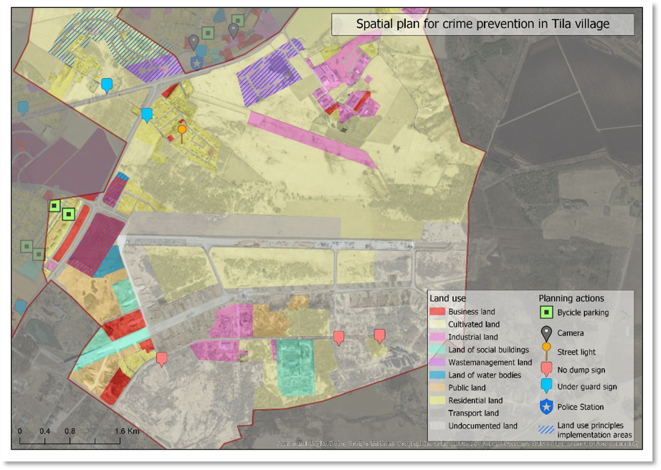

Slide 24
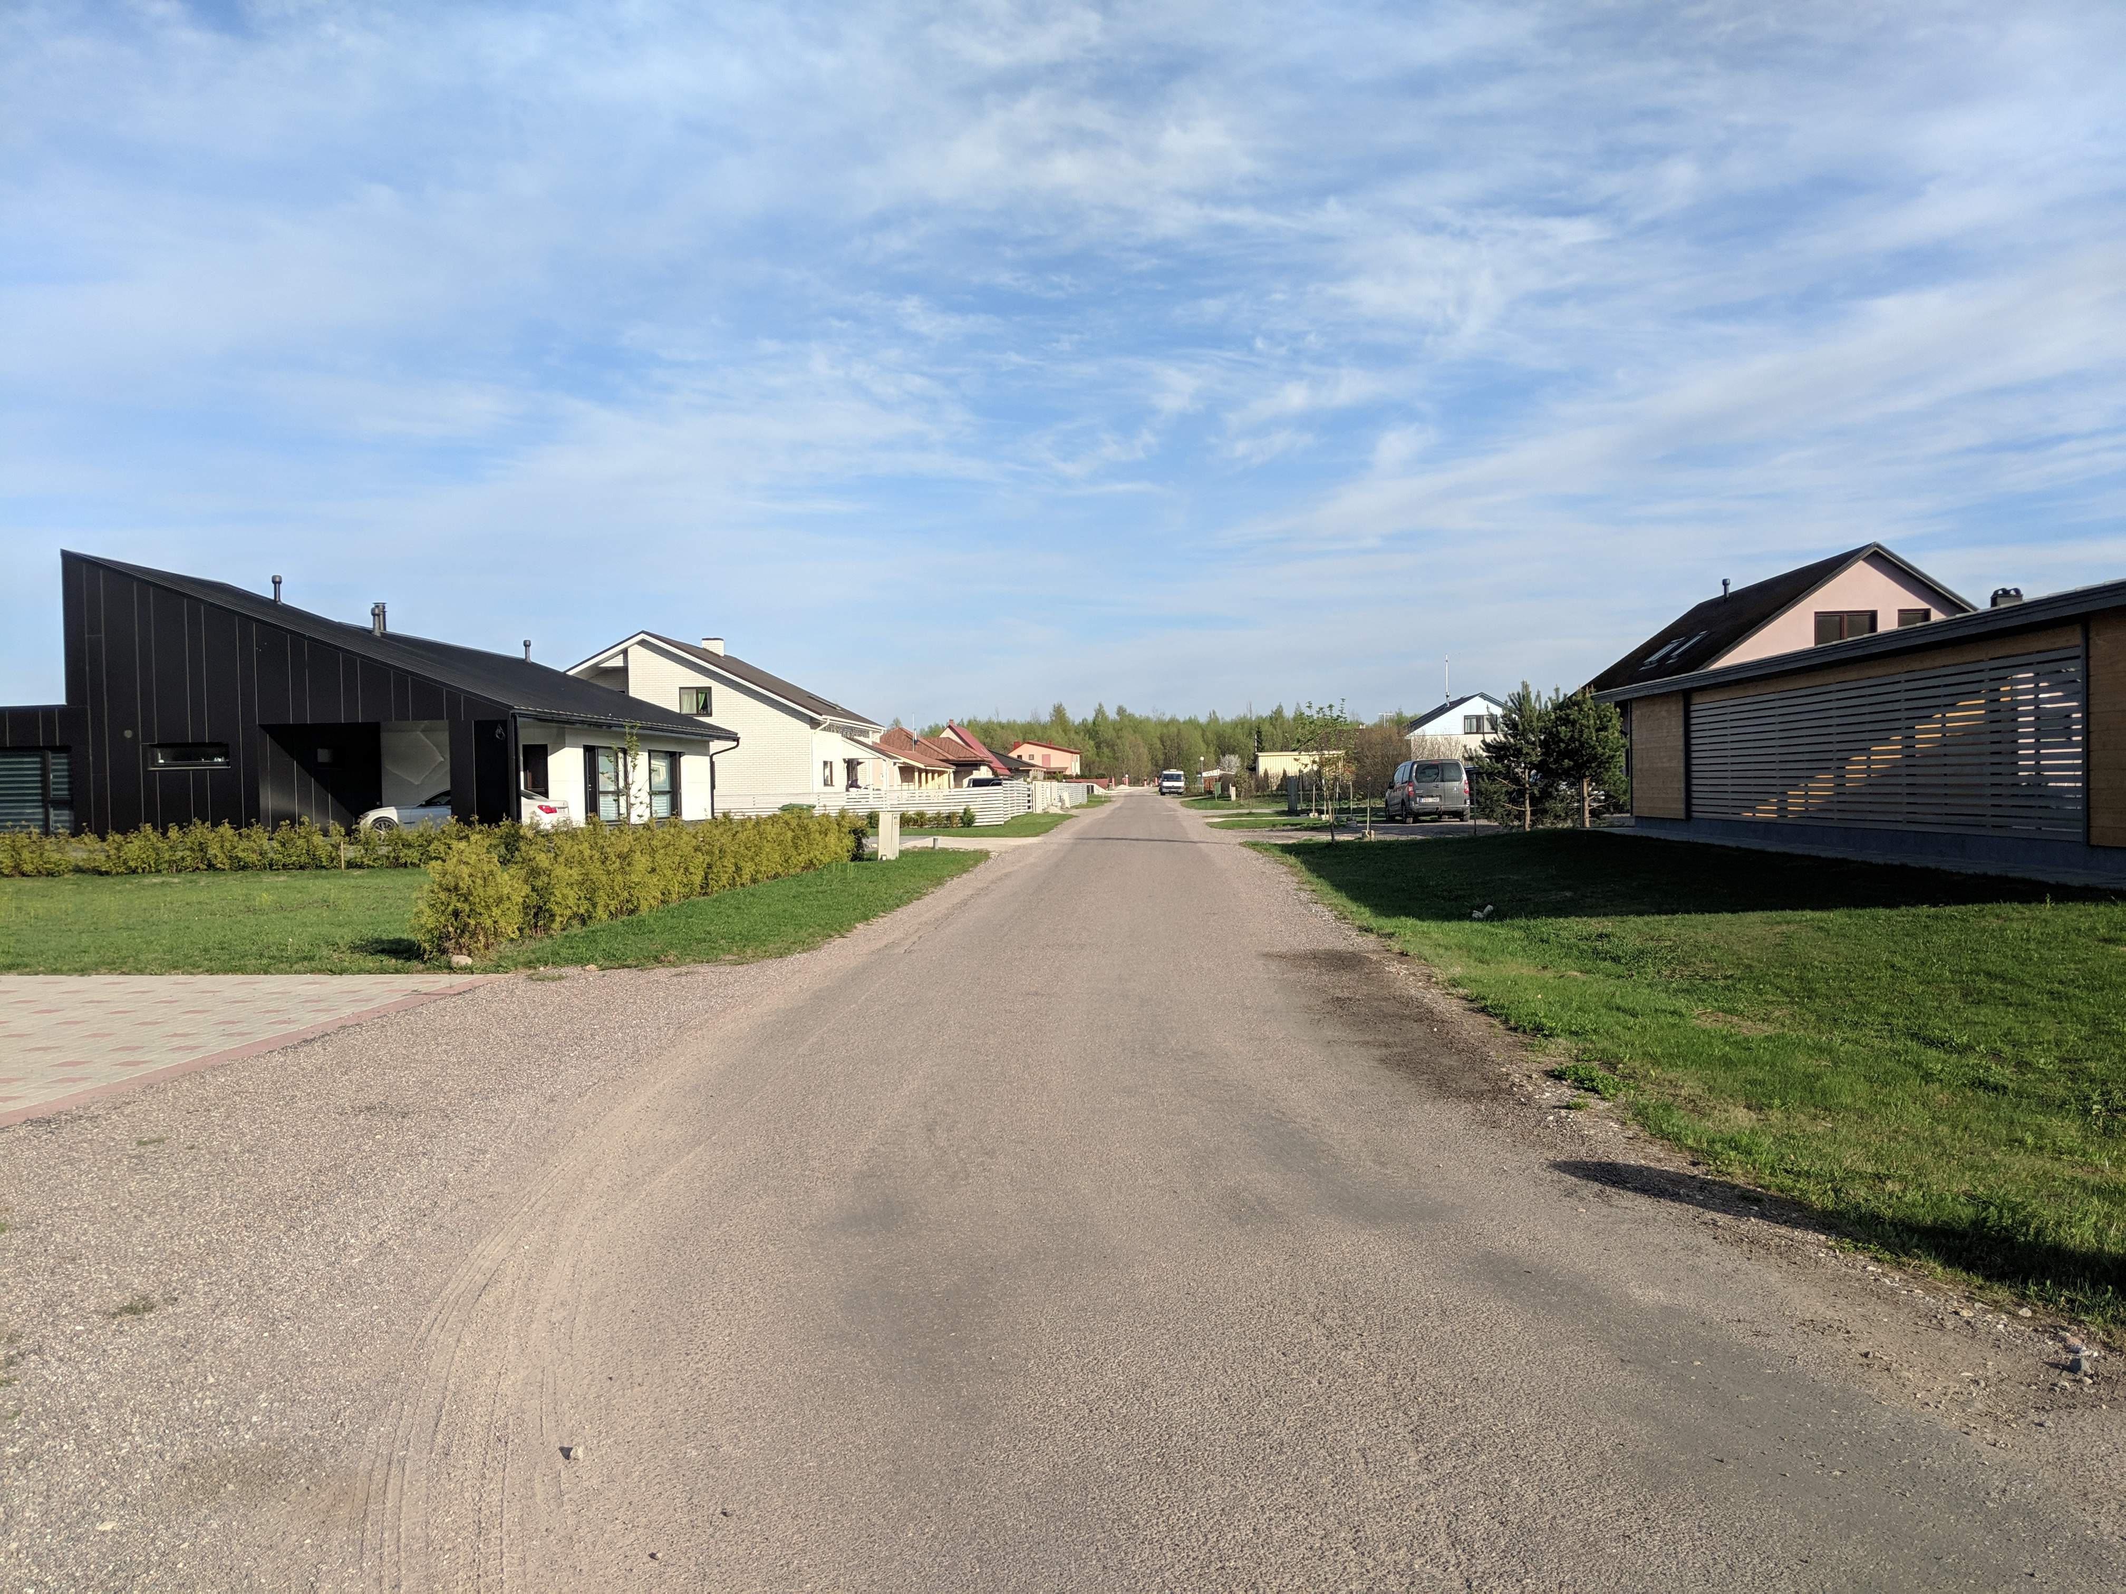
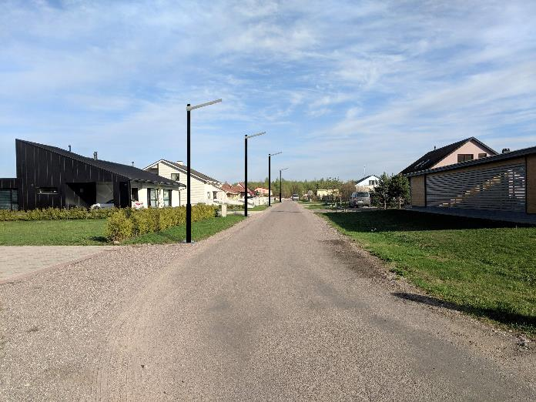

Slide 25
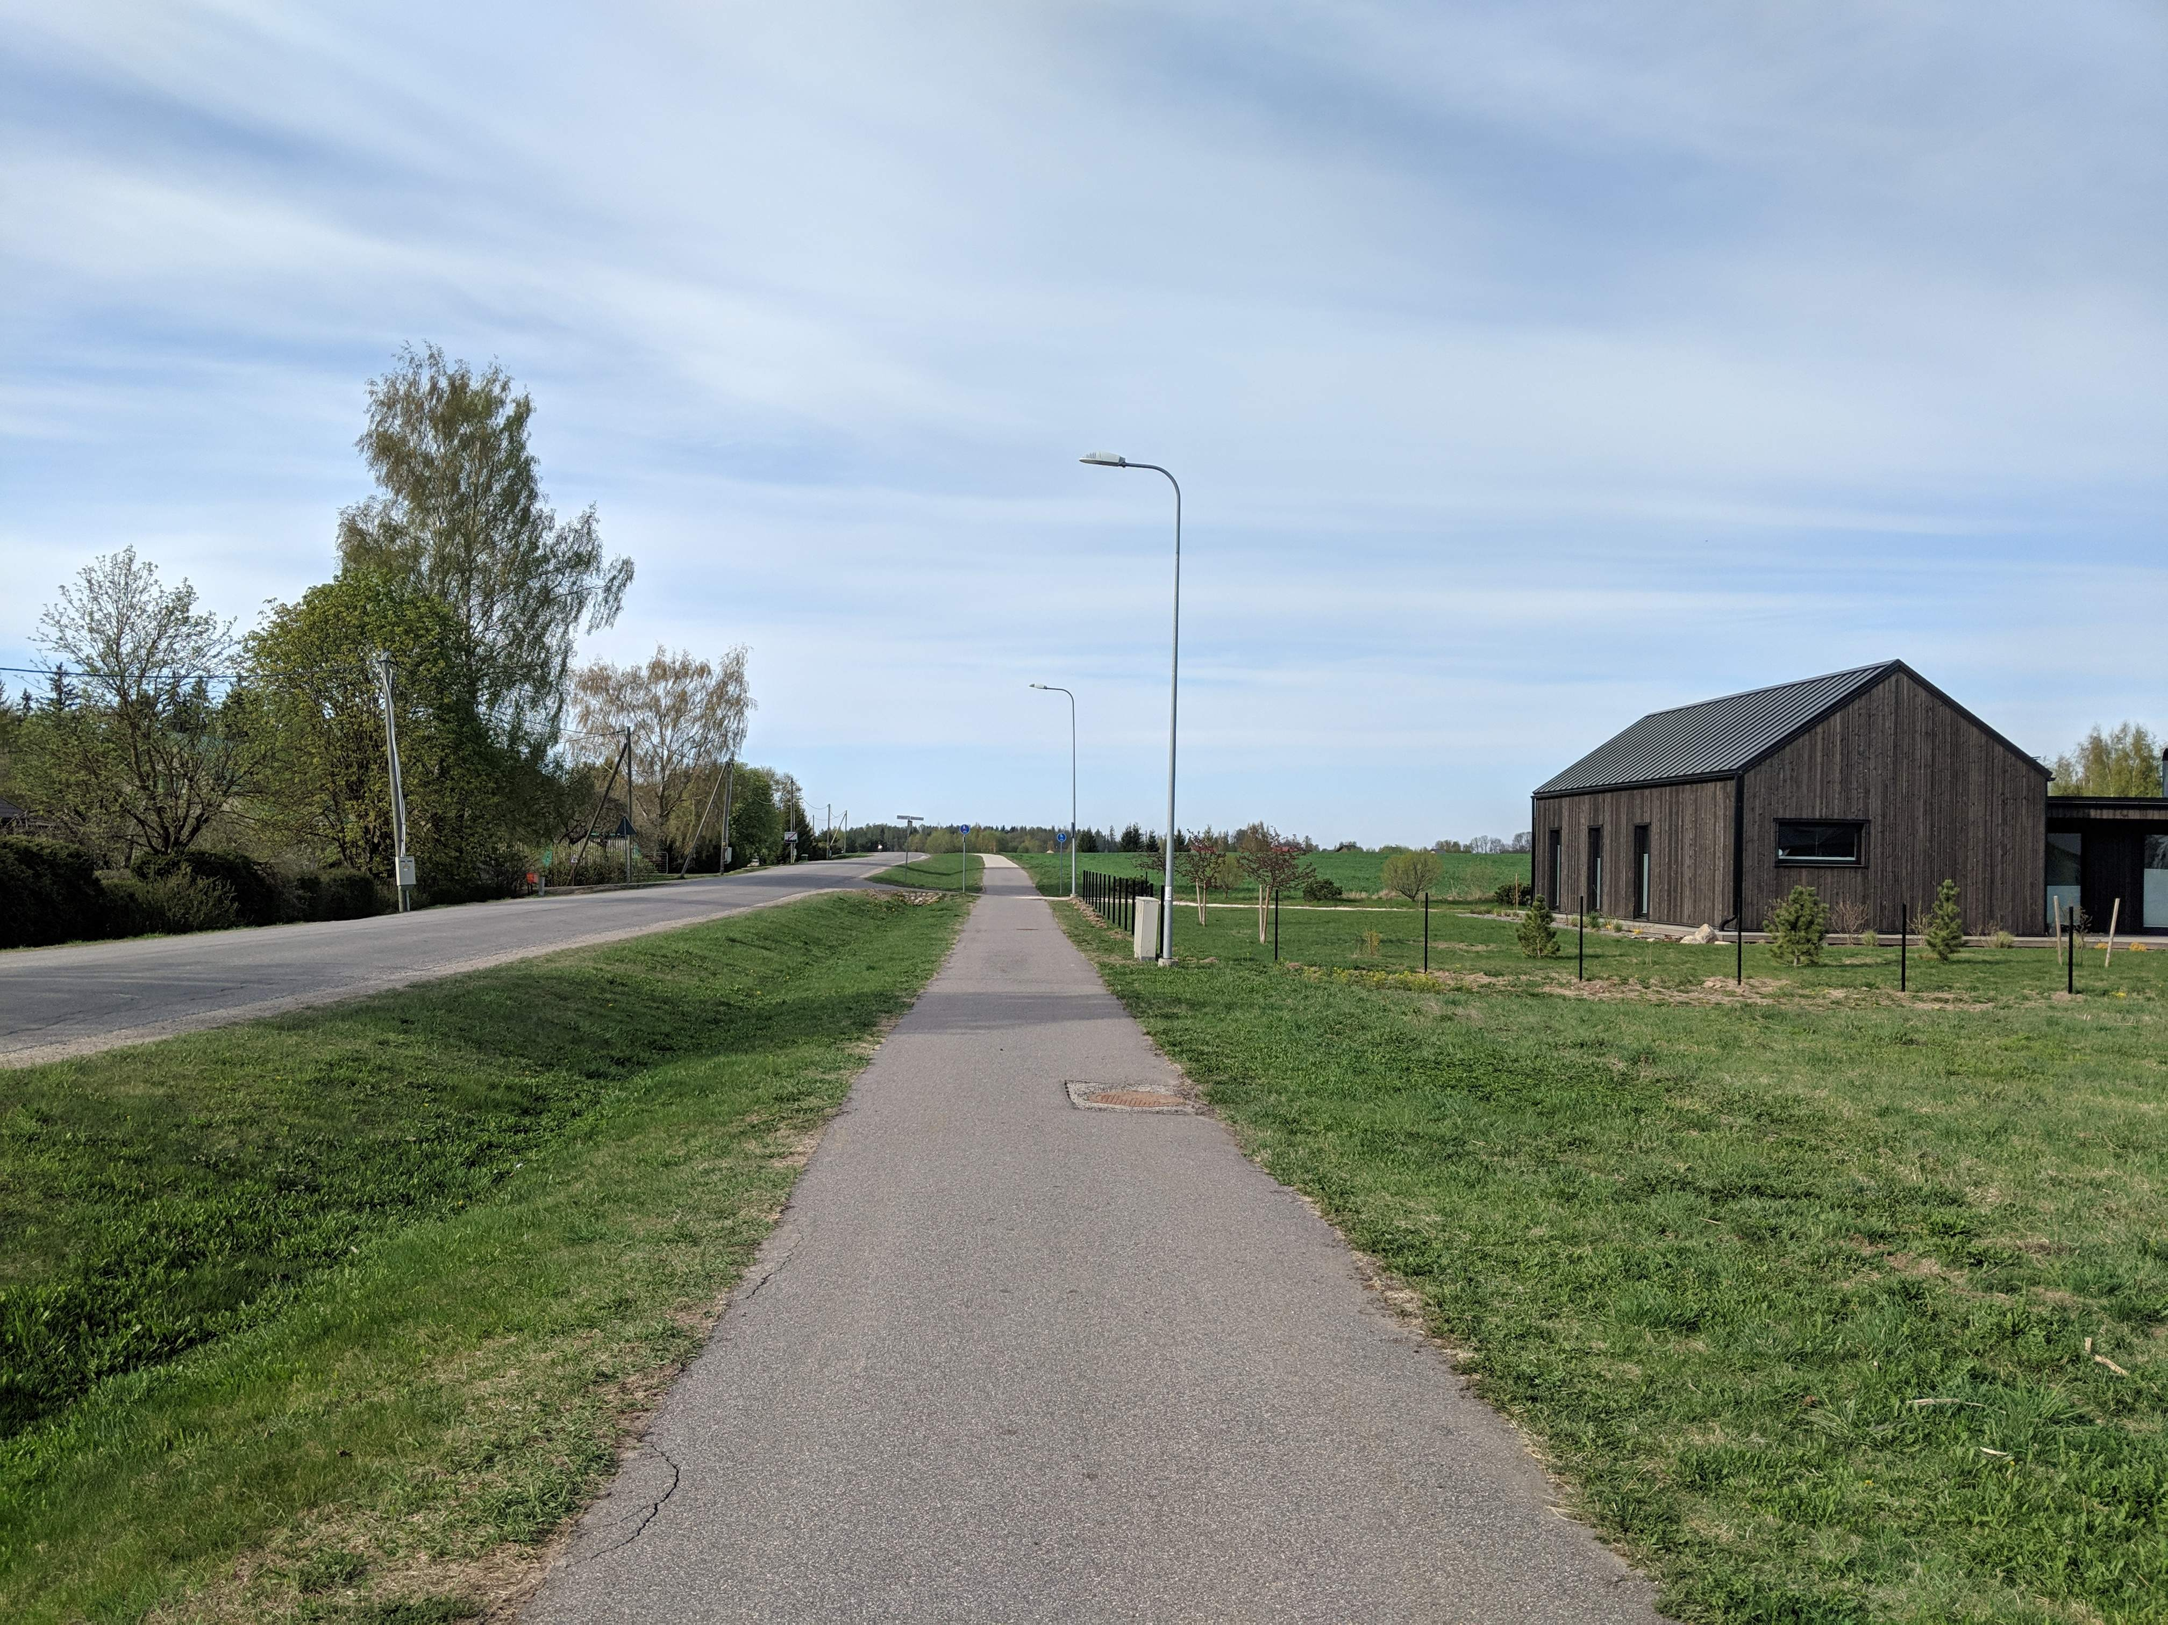


Slide 26
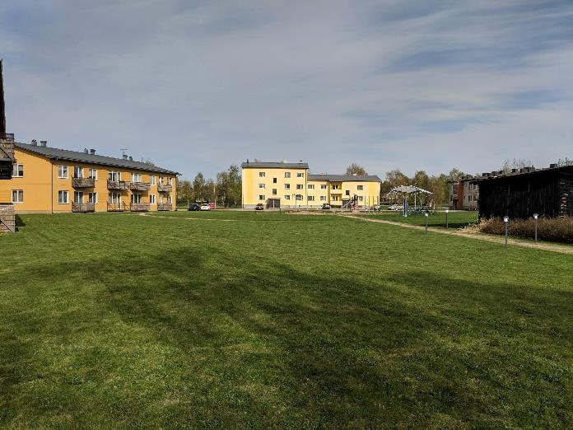
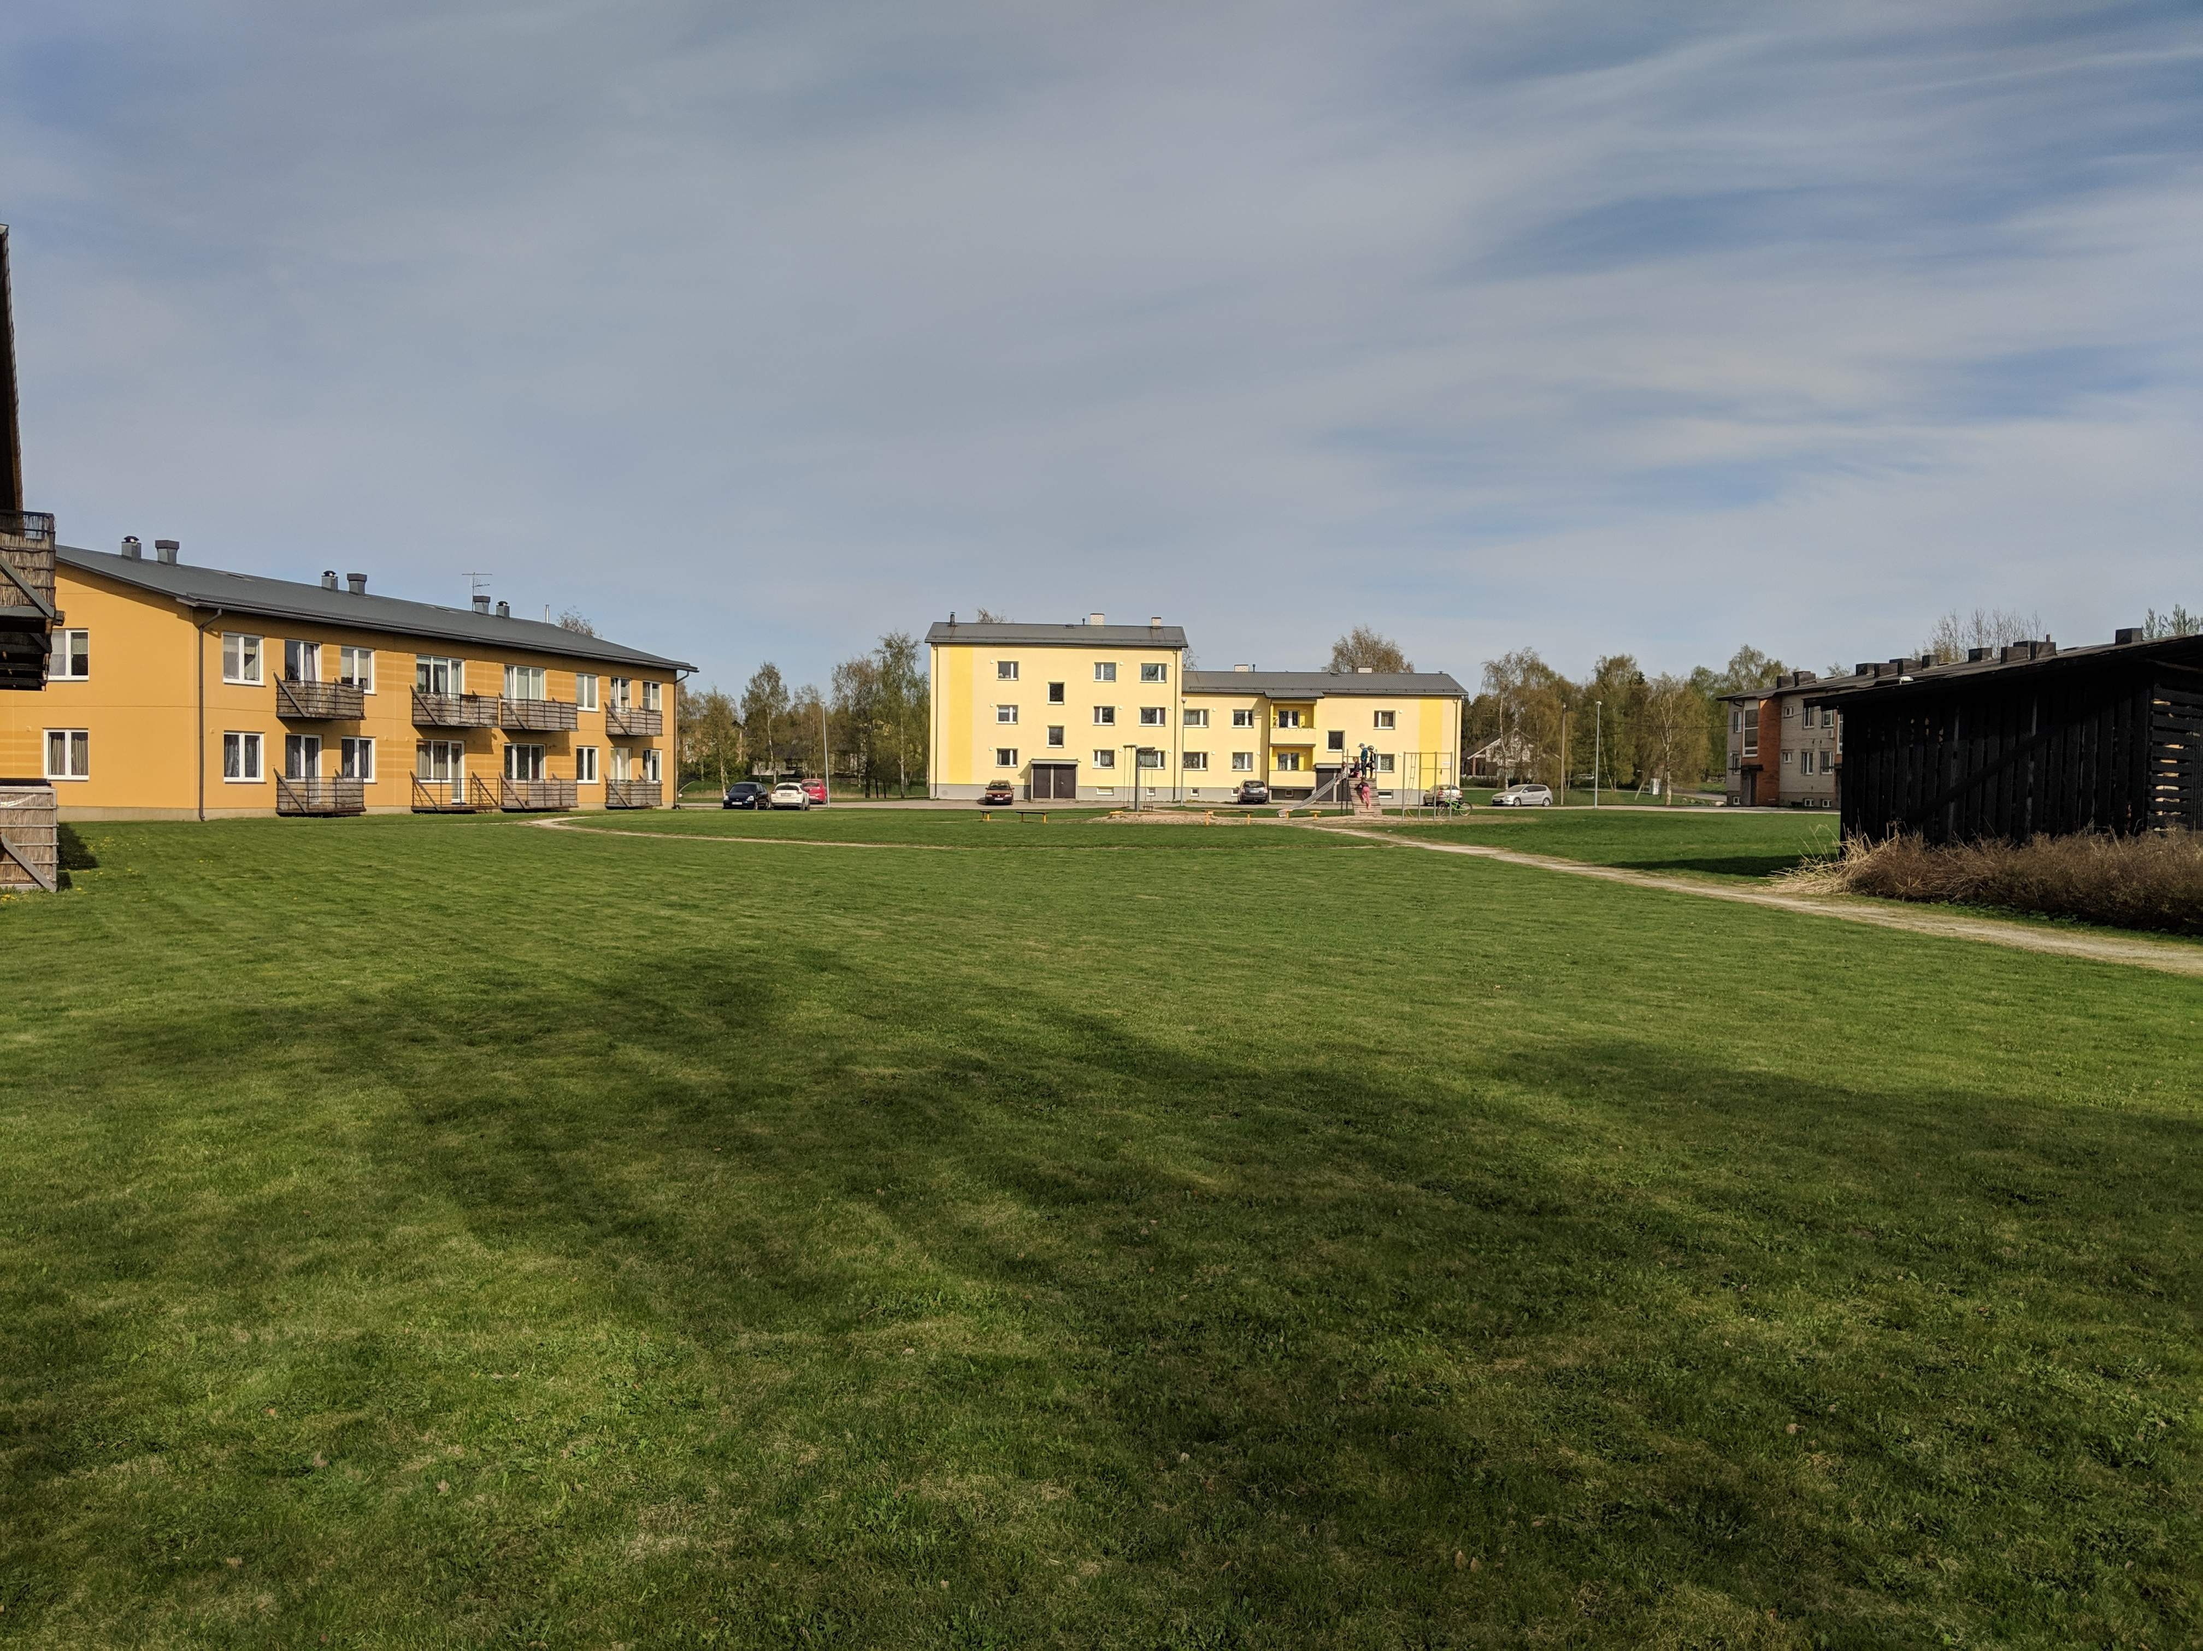

Slide 27
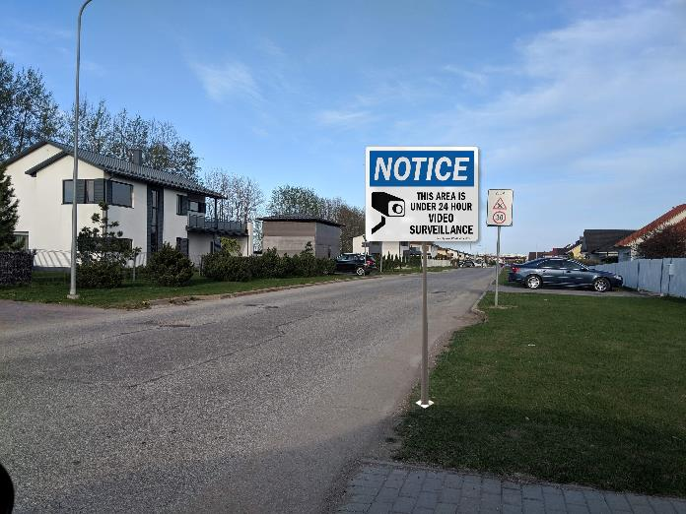
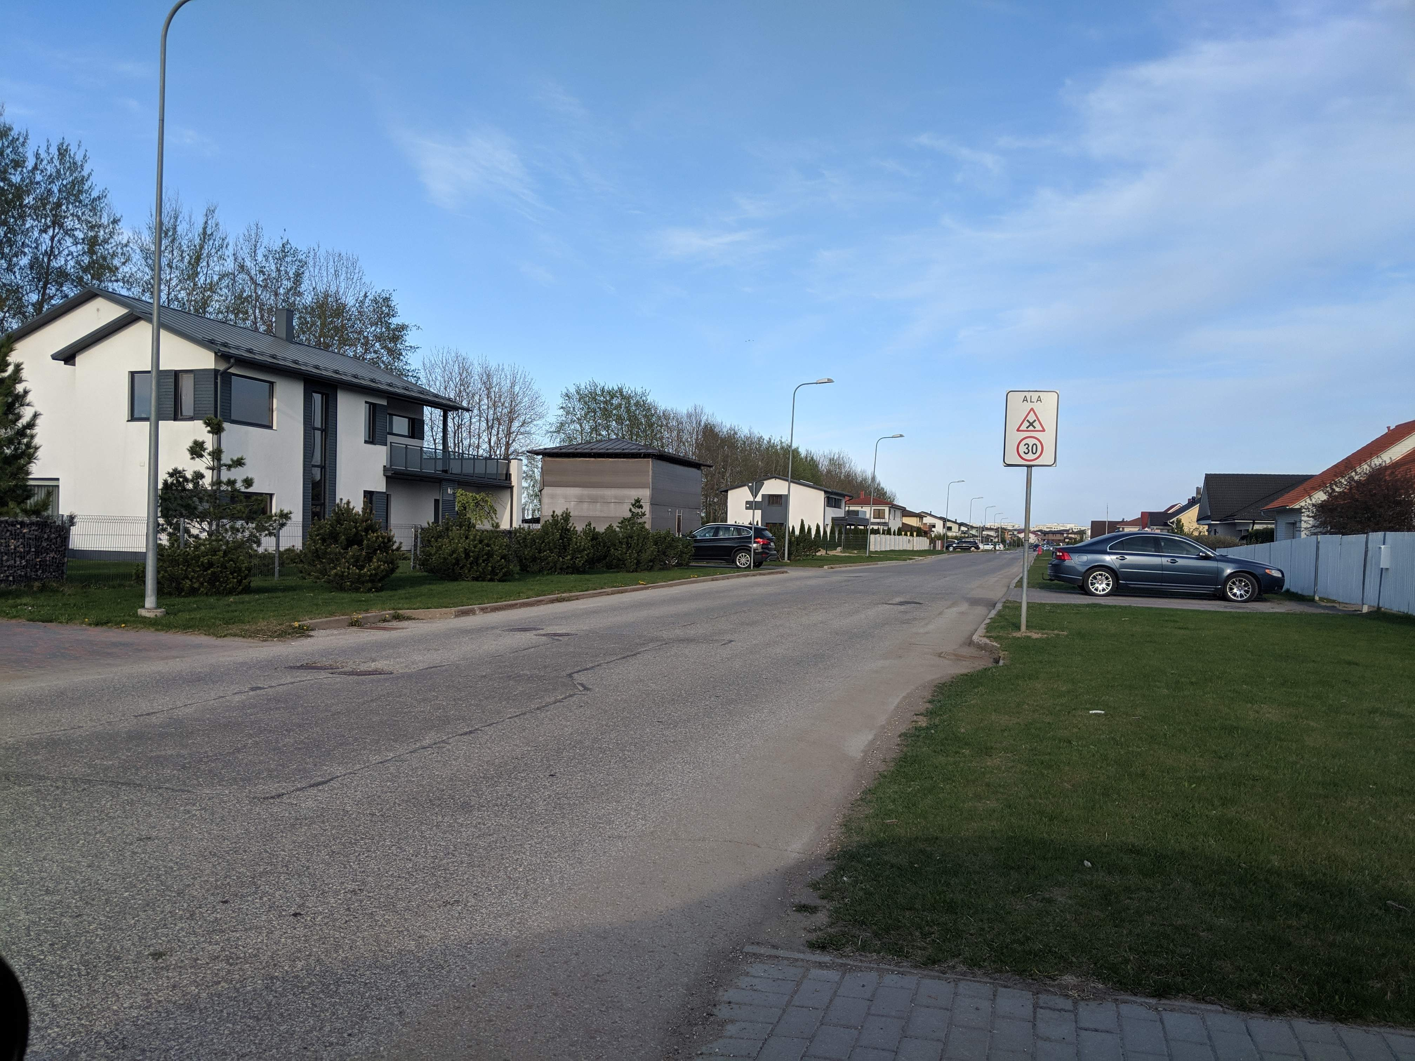

Slide 28
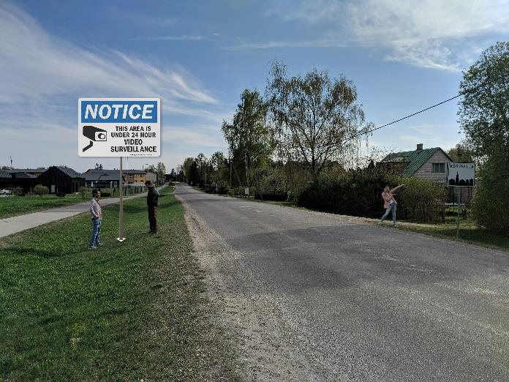
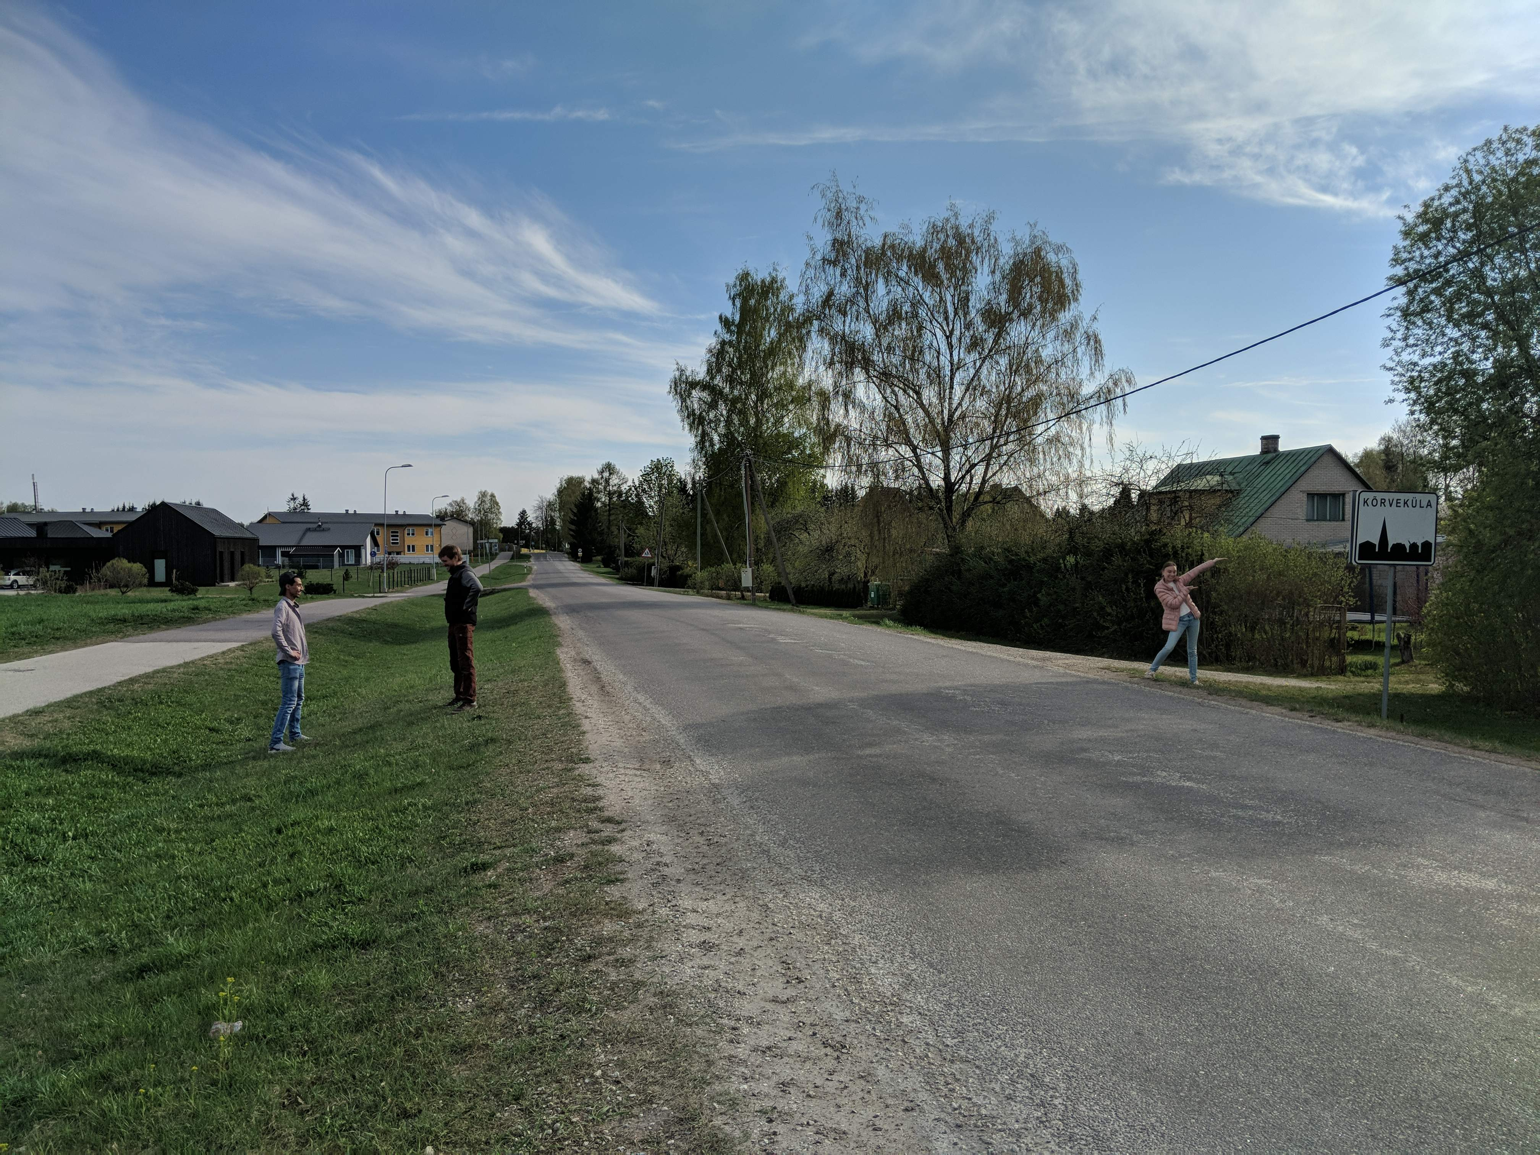

Slide 29
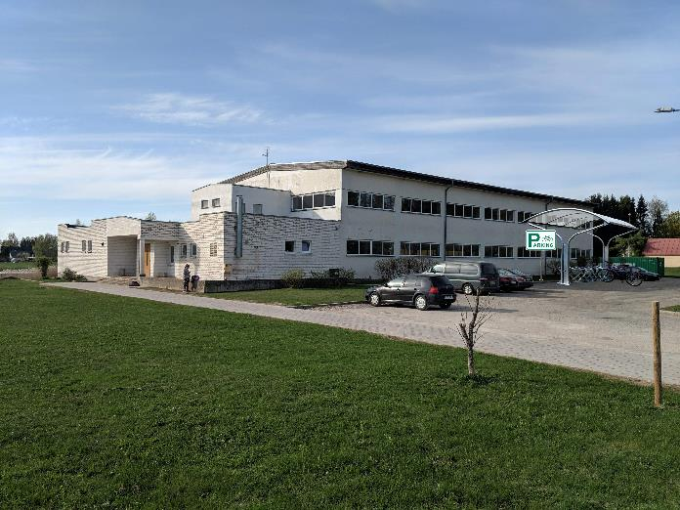
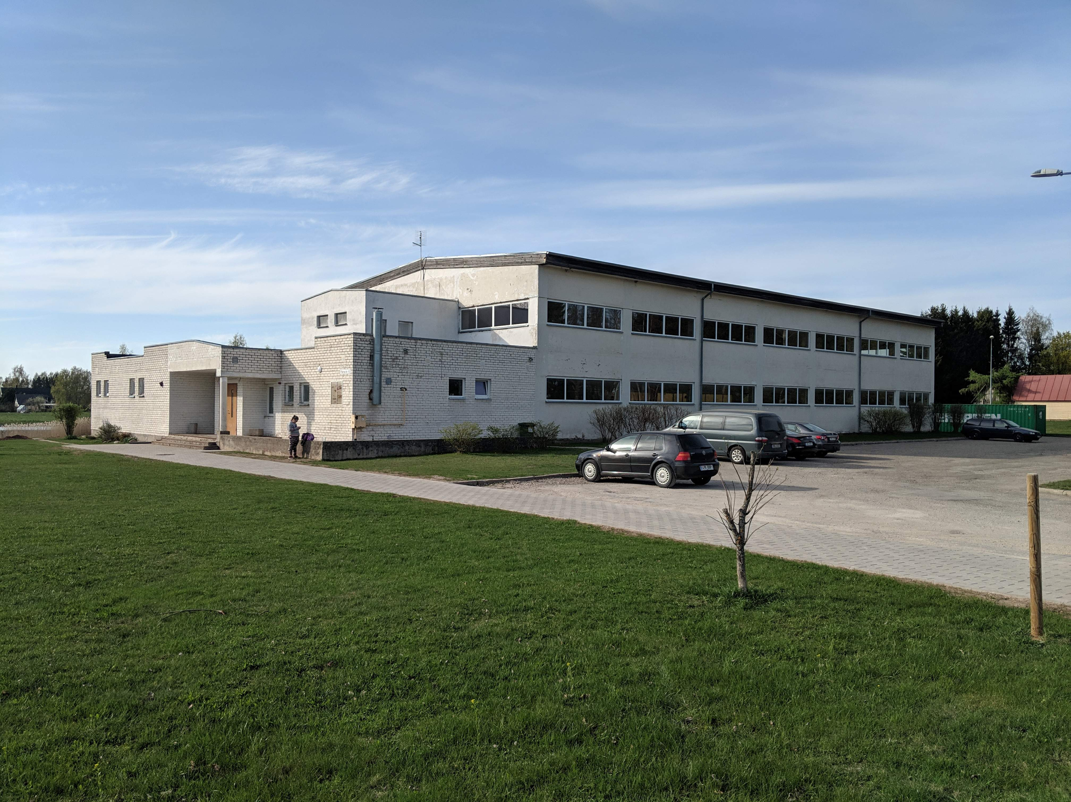

Slide 30
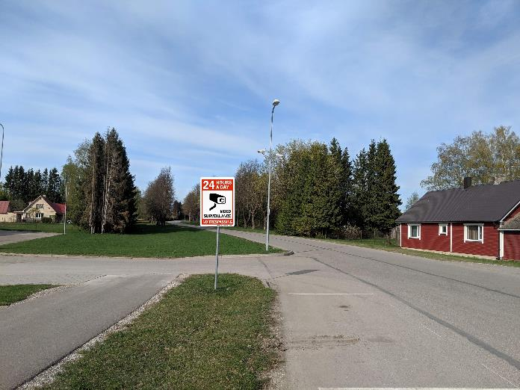
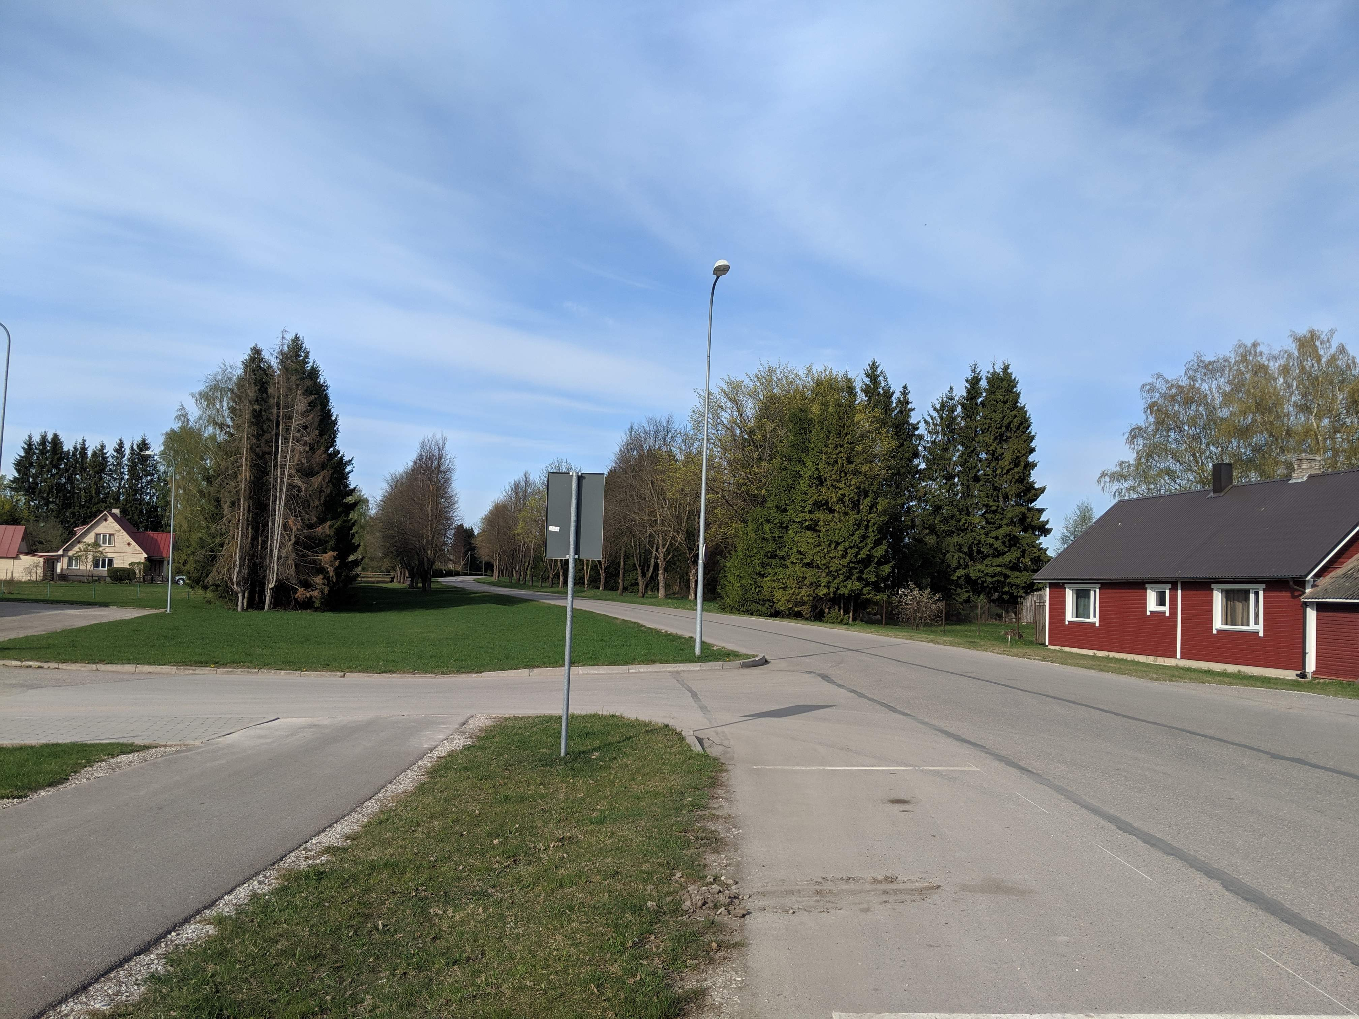

Slide 31
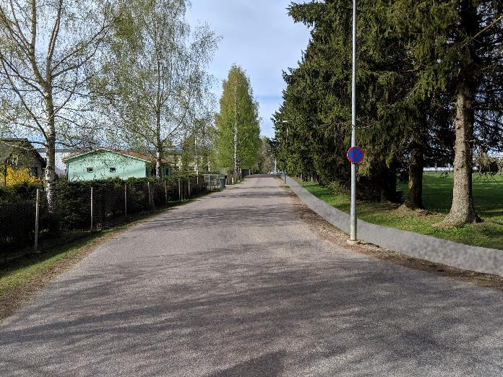
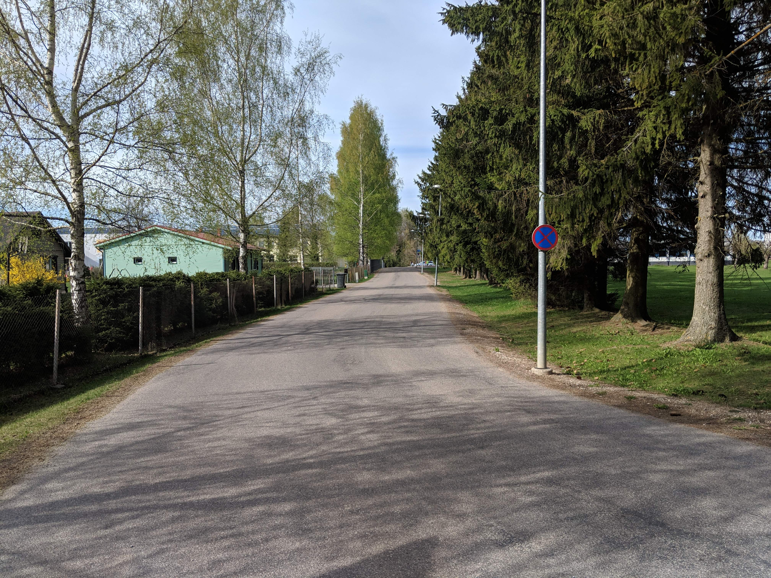

Slide 32
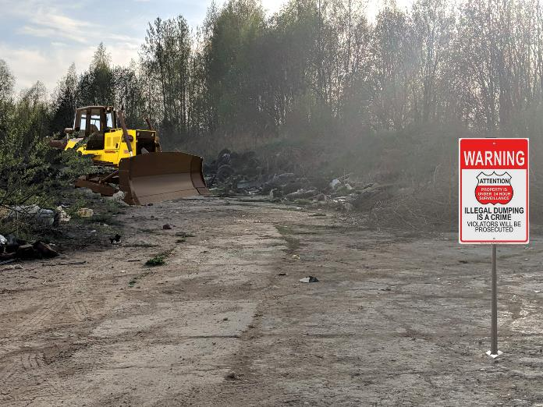
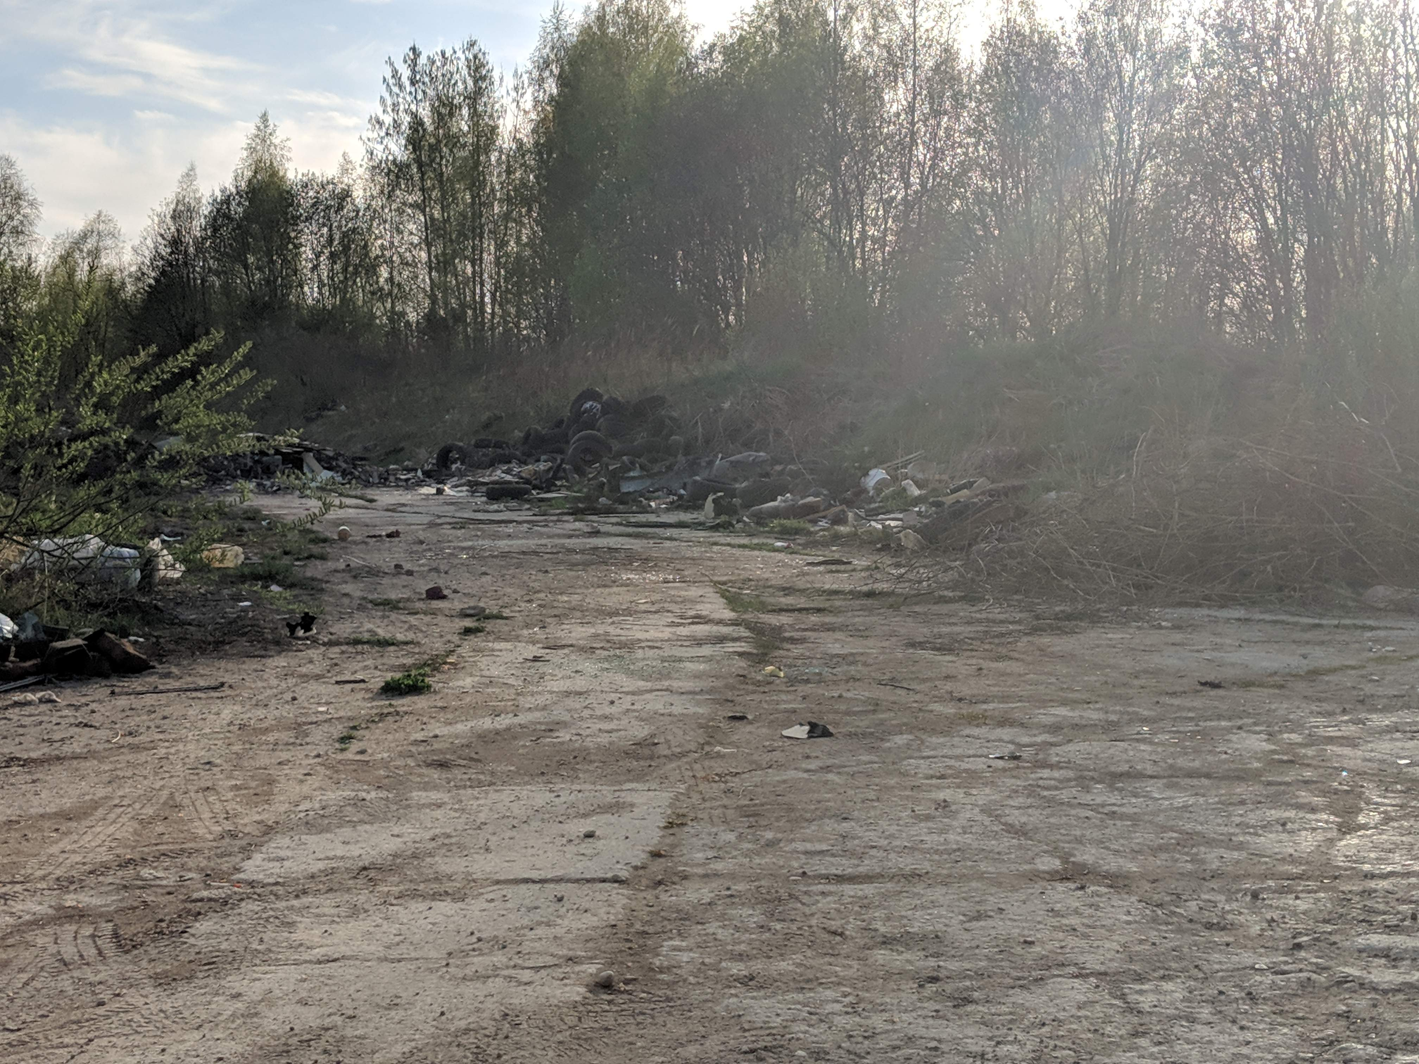

Slide 33
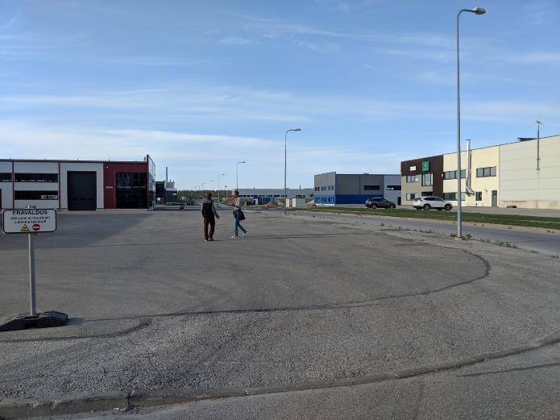

Slide 34
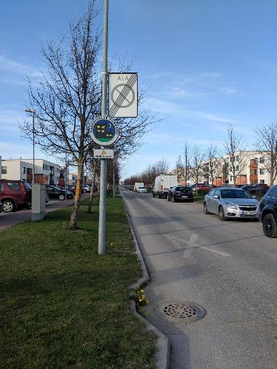
Safe neighborhood

Slide 35
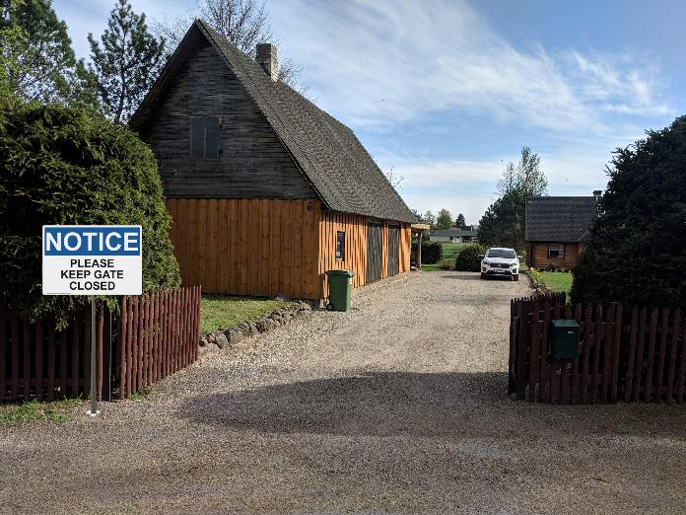

Slide 36
THANKS!
Any questions?

